Slide 1
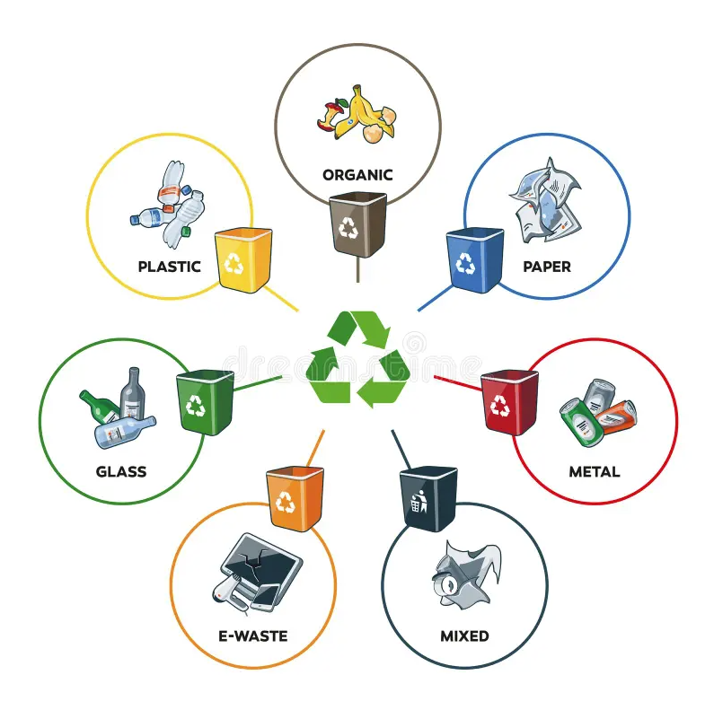
Garbage Classification Using Deep Learning
Course: Artificial Intelligence Laboratory
Presented by:
Hasibur Rahman Sun — 0112330199
Nafis Iqbal Neloy — 0112330617
Md. Mishkatul Bary — 0112330669
Abdullah Al Muhaimin — 0112330641
Farjana Akter — 0112330657
Jannatul Ferdaous — 0112330670

Slide 2
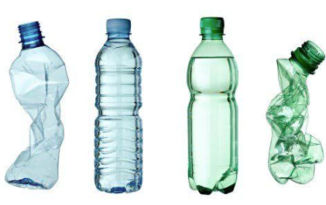
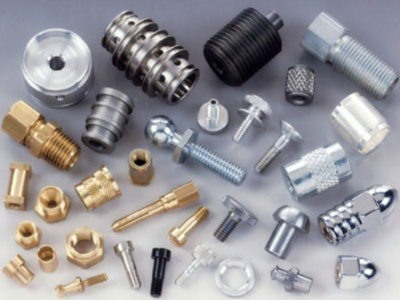
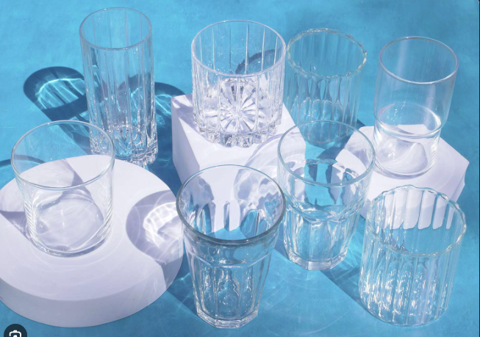

Problem & Objective
Problem
Manual waste classification is:
Time-consuming
Labor-intensive
Inconsistent
Real-world garbage images vary in:
Lighting
Orientation
Background
Appearance
Objective
Develop and evaluate an EfficientNet-B6-based system for classifying garbage images into 10 categories.

Slide 3
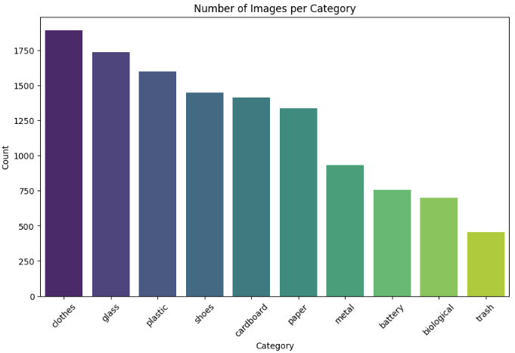
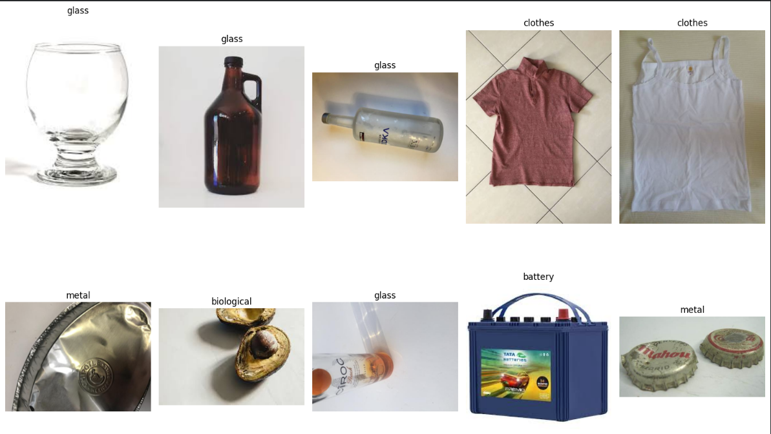
Dataset & Exploratory Data Analysis
Dataset: Garbage Classification V2 — Kaggle
Number of Classes: 10
EDA Performed
Class distribution analysis
Image resolution analysis
Random sample inspection
RGB intensity analysis
Corrupted image checking
Observation: The dataset contains
unequal numbers of images across
categories.
Figure 1. Class Distribution Across the 10 Garbage Categories
Figure 2. Representative Samples from the Garbage Dataset

Slide 4
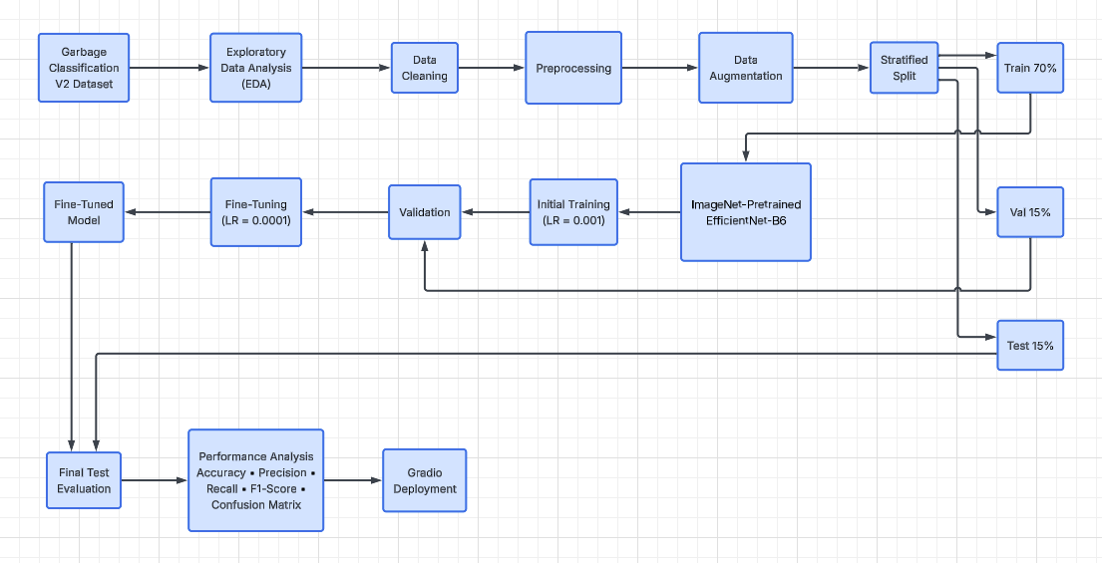
Proposed Methodology
An end-to-end transfer learning pipeline was developed for garbage image classification.
Figure3 . End-to-end workflow of the proposed EfficientNet-B6 garbage classification system.

Slide 5
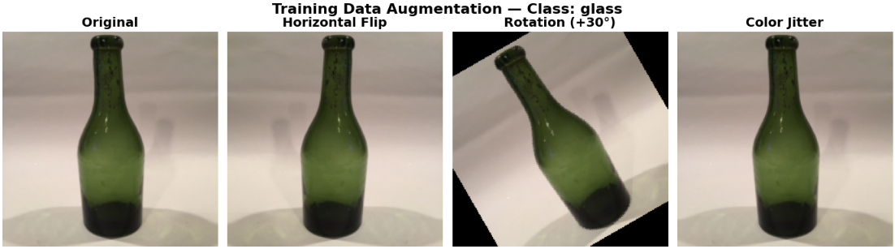
Data Preprocessing & Augmentation
Preprocessing
Resize: 224 × 224 pixels
RGB image input
Tensor conversion
ImageNet normalization
Training Augmentation
Horizontal & vertical flipping
Random rotation: +30°
Brightness adjustment
Contrast adjustment
Dataset Split
70% Training | 15% Validation | 15% Testing
Figure 4. Example of training data augmentation applied to a glass-class image.

Slide 6
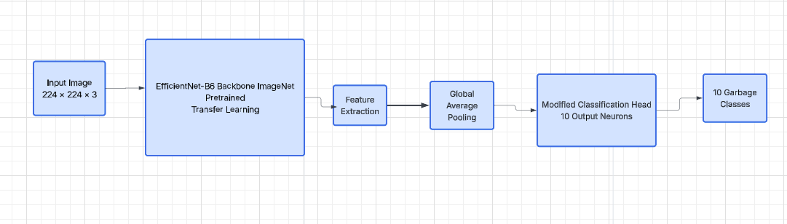
EfficientNet-B6 Transfer Learning
Model
ImageNet-pretrained EfficientNet-B6
Final classifier modified for 10 classes
Transfer learning with fine-tuning
Training Configuration
Framework — PyTorch
Loss — CrossEntropyLoss
Optimizer — Adam
Batch Size — 16
Initial LR — 0.001
Fine-Tuning LR — 0.0001
Hardware — NVIDIA T4 GPU
Figure 5. Transfer learning architecture using ImageNet-pretrained EfficientNet-B6 for 10-class garbage classification.

Slide 7
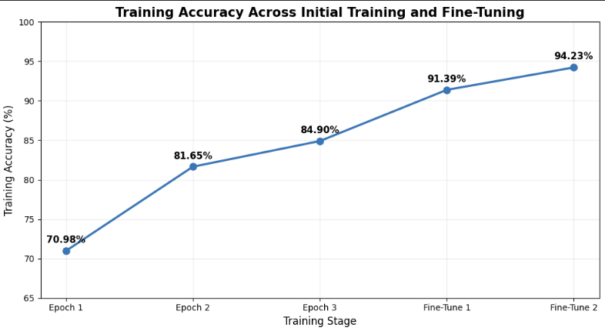
Training & Fine-Tuning Performance
Initial Training
Epochs: 3
Learning Rate: 0.001
Final Training Accuracy: 84.90%
Validation Accuracy: 85.10%
Fine-Tuning
Additional Epochs: 2
Learning Rate: 0.0001
Final Training Accuracy: 94.23%
Validation Accuracy: 93.47%
Figure 6. Training accuracy progression across initial training and fine-tuning..

Slide 8
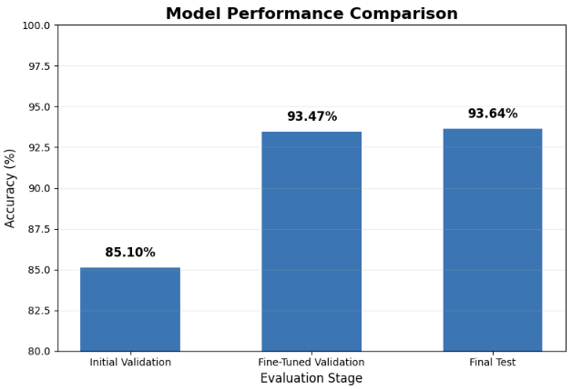
Final Model Evaluation
Final Test Accuracy: 93.64%
Evaluation Stage | Accuracy
Initial Validation | 85.10%
Fine-Tuned Validation | 93.47%
Final Test | 93.64%
Fine-tuning improved validation accuracy from 85.10% to 93.47%,
while the final model achieved 93.64% accuracy on the held-out test set.
Figure 7. Accuracy comparison across different evaluation stages.

Slide 9
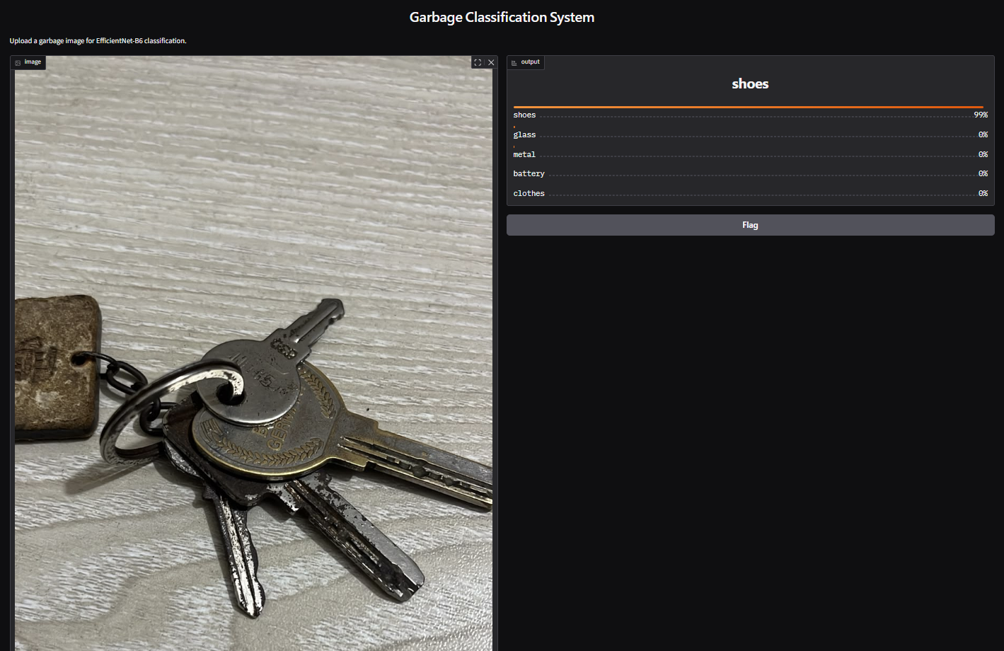
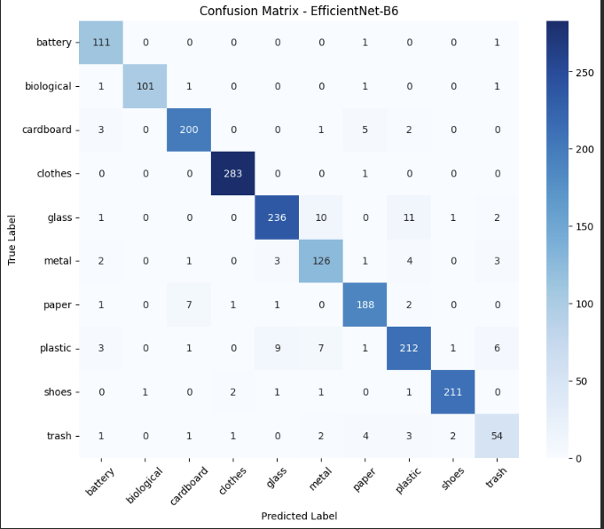
Class-Level Performance & Error Analysis
Evaluation Metrics
Precision , Recall
F1-Score , Confusion Matrix
Real-World Error Example
Actual Class: Metal
Predicted Class: Shoes
Observation: Similar visual features and real-world background variation can lead to incorrect predictions.
Figure 8. Confusion matrix of EfficientNet-B6 on the held-out test set.

Slide 10
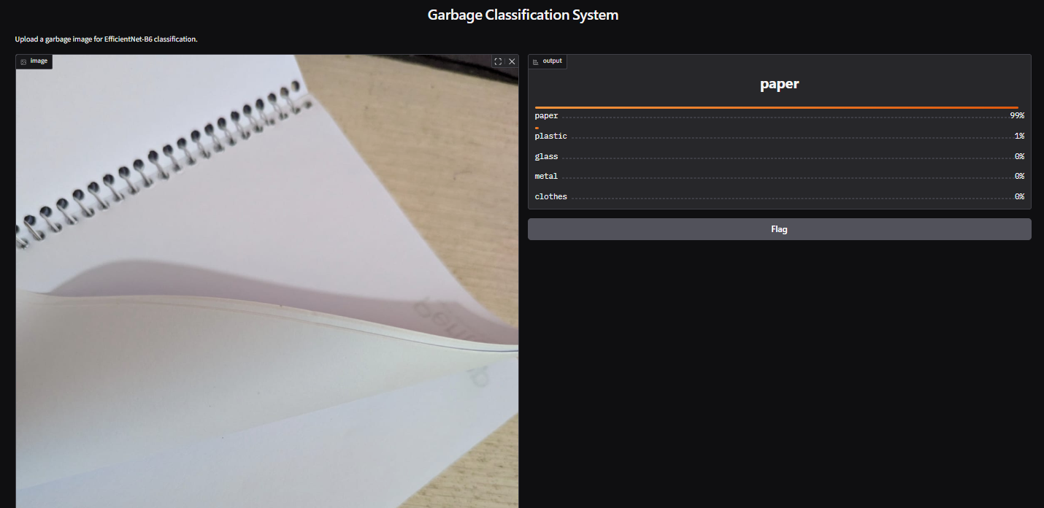
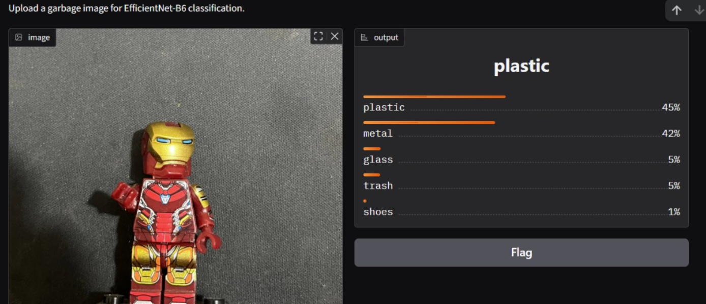
Prototype Deployment
Deployment Pipeline
Upload Image → Preprocessing → EfficientNet-B6 → Prediction
Implementation
Gradio-based interactive interface
Accepts user-uploaded garbage images
Applies the same inference preprocessing
Returns class probabilities
Displays the top predicted categories
a. Successful Prediction — Paper
b. Challenging Real-World Input

Slide 11
Conclusion & Future Work
Conclusion
- Developed an end-to-end garbage classification pipeline
-Applied transfer learning using EfficientNet-B6
-Validation accuracy improved from 85.10% to 93.47%
-Achieved 93.64% test accuracy
-Implemented a functional Gradio prototype
Future Work
Expand and balance the dataset
Improve robustness to real-world backgrounds and lighting
Perform further hyperparameter optimization
Analyze difficult and misclassified samples
Explore lightweight deployment for mobile/edge devices
Overall, EfficientNet-B6 demonstrated strong performance for garbage classification while revealing opportunities to improve real-world generalization.

Slide 12
REFERENCES
[1] Garbage Classification V2, Kaggle. Dataset: sumn2u/garbage-classification-v2
[2] M. Tan and Q. V. Le, “EfficientNet: Rethinking Model Scaling for Convolutional Neural Networks,” Proceedings of ICML, 2019.
[3] PyTorch and TorchVision Documentation, PyTorch Foundation.
Thank you! ☺

